Slide 1

Intrusion prevention systems
H17M 34

Slide 2

Signature Alarms
The capability of IDS and IPS sensors to accurately detect an attack or a policy violation, and generate an alarm is critical to the functionality of the sensors.
There are a number of states which can be reported.

Slide 3
False Positives
Like a false alarm; your house alarm goes off, but there is no burglar. In web application security, a false positive is when a web application security scanner indicates that there is a vulnerability on your website, such as SQL Injection when, in reality, there is not.
When checking for false positives, you want to ensure that they are indeed false. By nature, we humans tend to start ignoring false positive rather quickly. For example, web application security scanner detects 100 SQL Injection vulnerabilities.
If the first 20 variants are false positives, the penetration tester assumes that all the others are false positives and ignore all the rest. By doing so, there are chances that real web application vulnerabilities are left undetected. This is why it is crucial to check every vulnerability and deal with each false positive separately to ensure false positives.

Slide 4
False negative
A false negative occurs when a signature is not fired when offending traffic is detected. Offending traffic ranges from someone sending confidential documents outside of the corporate network to attacks against corporate web servers.
No alerts, no bells went off, there were no sirens, but something bad actually did get through your security systems. This got right through your defences.
False negatives are bugs in the IDS and IPS software and should be reported. A false negative should be considered a software bug only if the IDS and IPS have a signature that has been designed to detect the offending traffic.

Slide 5
True positive
A true positive occurs when an IDS and IPS signature is correctly fired, and an alarm is generated, when offending traffic is detected.
For example, consider a Unicode attack. Cisco IPS sensors have signatures that detect Unicode attacks against Microsoft Internet Information Services (IIS) web servers.
If a Unicode attack is launched against Microsoft IIS web servers, the sensors detect the attack and generate an alarm.

Slide 6
true negative
A true negative occurs when a signature is not fired when nonoffending traffic is captured and analysed. In other words, the sensor does not fire an alarm when it captures and analyses “normal” network traffic.
An alert has correctly not been generated when a specific activity has not occurred.
If a signature was designed to detect a certain type of malware, and no alert is generated without that malware being launched, then this is a true negative, which is also desirable.

Slide 7

Misconfiguration Attacks
Each security system needs to be designed by the administrator for some factors to reflect a part of security strategy it imposes and to safeguard that the system provides the functionality that the users need. This usually means turning on several options.
The desired features work well after the administrator establishes the right options.
However, a problem might occur when the administrator forgets to switch off those options when they are unnecessarily needed after a while.
Any misconfiguration or weak configuration can be used by intruders either to skip a security barrier or to find out about a security breach. As a result, misconfiguration or missing patch has become one of the most substantial weaknesses the enterprises face recently and an estimate shows that misconfiguration attacks will account for 70% of successful WLAN attacks.

Slide 8
Fuzzy Logic Probability calculation IPS
Imagine a word that is not coloured only in black and white, ruled not only by right and wrong or true and false, imagine the grey colour and the reality of not being absolutely right or merely wrong and then you will find yourself in the fuzzy word.
Fuzzy logic extends traditional logic, enabling it to handle calculations and language variables. For example, one can say “It may be snowing in the evening”. In this statement “may” can be interpreted as “there is a 50% probability of snowing in the evening”.

Slide 9
Intrusion Prevention Systems Utilising A.I Machine Learning
The main challenge to a Cybersecurity specialist concerning host and network protection is stopping unauthorised access to a network system.
Risks:
Access to devices on the network
Malware injection
Data exfiltration
Network crash

Slide 10
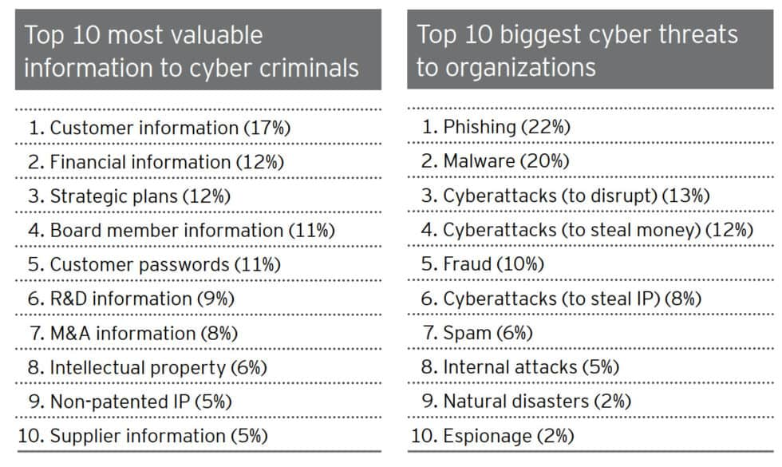
Intrusion prevention systems (IPS)

Slide 11
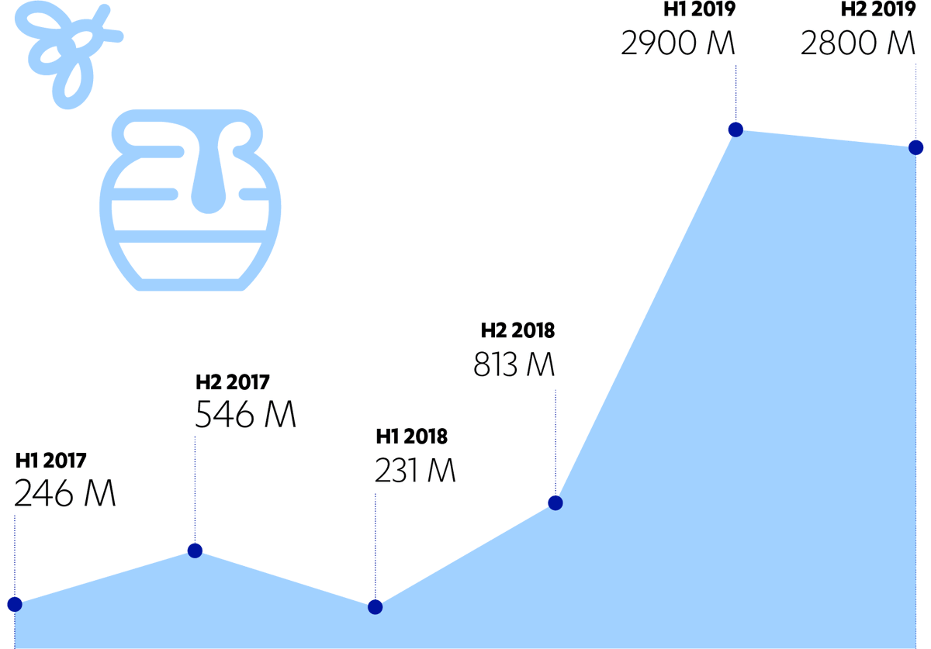
Honeypot attack detection
As the image displays, attacks rose by more than 2 billion within two years from 2017 - 2019

Slide 12
Security Policy Enforcement
Your IPS has the capability to enforce your security policy because your IPS has the capability to modify and drop traffic entering your network.
For example, many applications, such as peer-to-peer software, use a destination port of TCP port 80 because this traffic is usually allowed by most firewall policies.
The firewall might not be able to distinguish between HTTP traffic going to TCP port 80 and another program, such as uTorrent , using the same port.
With an IPS, you can monitor traffic to TCP port 80 and verify its compliance with RFC 2616, “Hypertext Transfer Protocol HTTP ” thus ensuring that your firewall is allowing only HTTP traffic through for TCP port 80.
A Request for Comments (RFC) is a publication from the Internet Society (ISOC) and its associated bodies, most prominently the Internet Engineering Task Force (IETF), the principal technical development and standards-setting bodies for the Internet.

Slide 13
Intrusion prevention systems
IPSs provide a proactive component that integrates very effectively into your overall network security framework.
Combining Intrusion Prevention with other security components, such as an IDS and perimeter firewalls, provides a robust defence-in-depth network security solution.
Intrusion Prevention technology enables you to stop intrusion traffic before it enters your network by placing the sensor as a Layer 2 (Ethernet layer) forwarding device in the network.
One of the main benefits of Network Intrusion Prevention is the ability to stop intrusive traffic from reaching the target system.

Slide 14

Intrusion prevention systems (IPS)
Network Intrusion Prevention is not without its limitations, such as monitoring traffic concerning all the hosts on a single subnet.
These limitations, nonetheless, usually can be mitigated by integrating Intrusion Detection and host-based examination in addition to purely using Network Intrusion Prevention. A hybrid IPS provides you with the ability to perform IPS and IDS functionality using the same sensor.
Some of the abilities shared equally with IPS and IDS structures include the undermentioned:
Generating alerts
Initiating IP logging
Resetting TCP connections
Initiating IP blocking

Slide 15
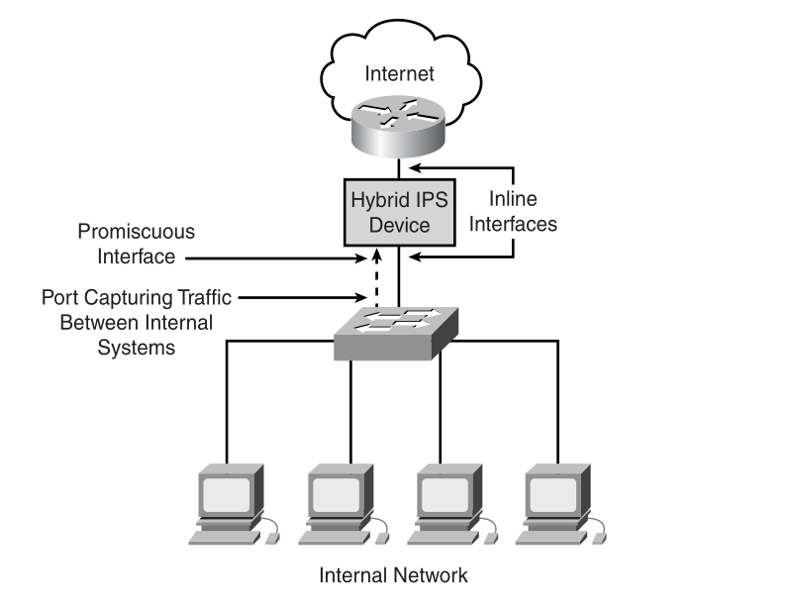
Intrusion Prevention Systems (IPS)
The ability to monitor when your network is under attack. Your IDS or IPS should be able o generate alerts to indicate that an attack has been launched against your network even if the intrusion software not permitted that attack from succeeding.
These alerts enable you to compare activity on your network between security devices such as IPS and IDS sensors, as well as other infrastructure equipment.

Slide 16

Thank you
someone@example.com

